Slide 1
Interpretation of 3D CNNs for Brain MRI Data Classification

Slide 2
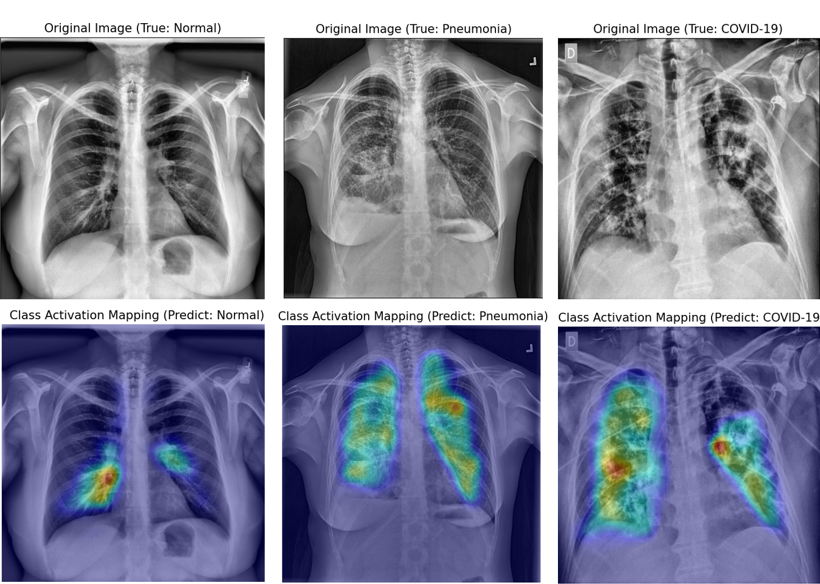
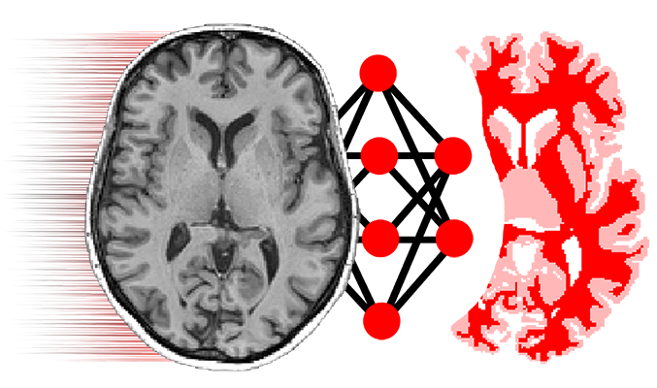
PROBLEM MOTIVATION
Problem: existing methods of interpretation have not reached a sufficient level of trust to be applied as support and decision-making systems.

Slide 3
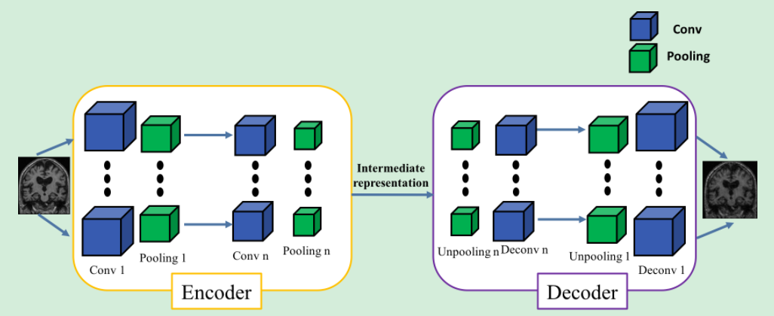
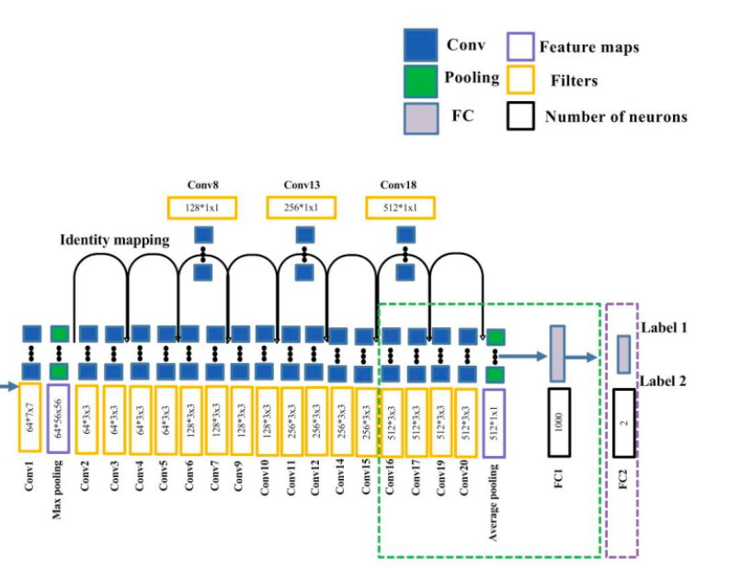
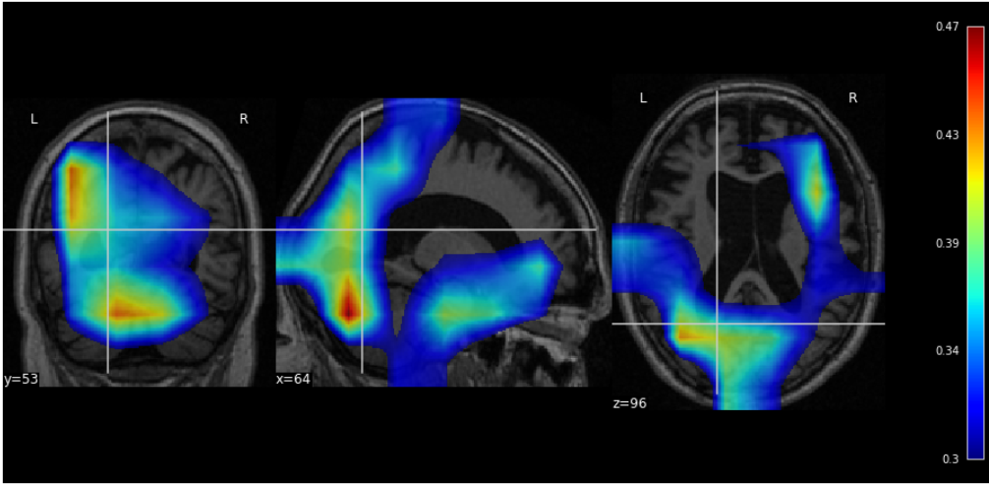
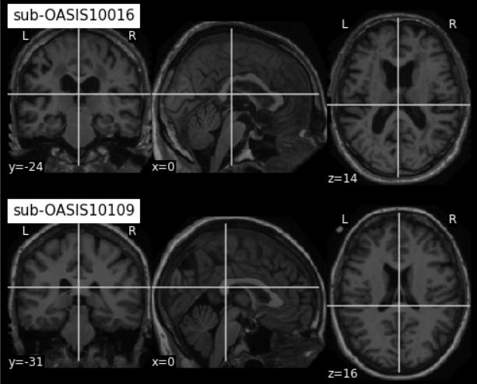
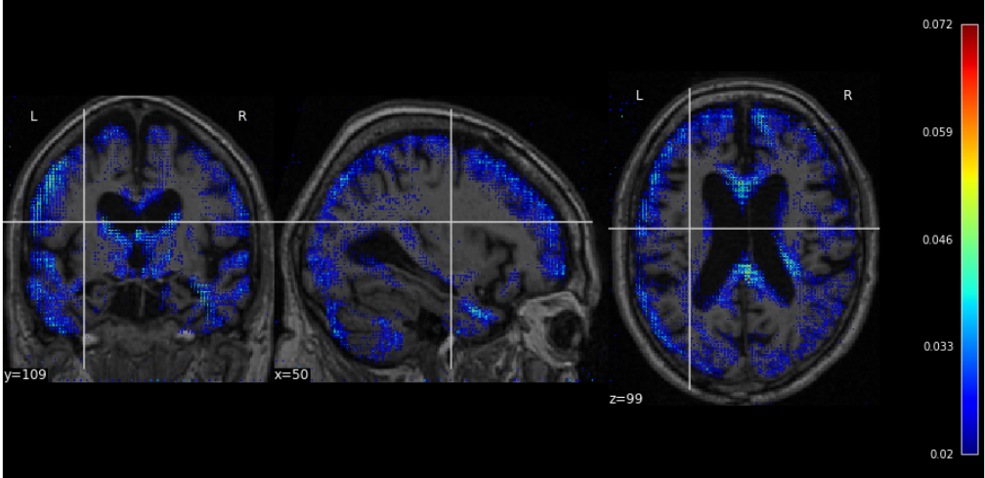
METHODS
Transfer learning based on AE
Baseline 3D CNN
3D CNN + tranf.learning
3D CNN

Slide 4
Interpretation methods
Gradient-based backpropagation methods: Methods that backpropagate an importance signal from the output towards the input. The common idea is to compute the gradient of the network’s prediction with respect to the input, holding the weights fixed. This determines which input elements (e.g., which pixels in case of an input image) need to be changed the least to affect the prediction the most.
Perturbation-based forward propagation methods: Methods that perturb the input and probe its possible effects on the prediction of the network.

Slide 5
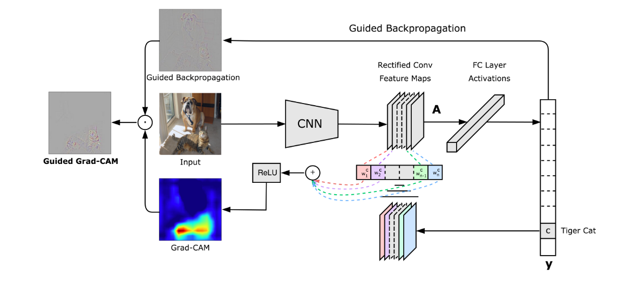
Grad-CAM – Gradient-weighted Class Activation Mapping
The Idea: to take the gradients of the target class flowing into the final convolutional layer to produce a heatmap highlighting the important regions in the image to predict the concept.
Grad-CAM: Visual Explanations from Deep Networks via Gradient-based Localization Ramprasaath R. Selvaraju ·https://arxiv.org/pdf/1610.02391.pdf
Notes:
From a high-level, we take an image as input and create a model that is cut off at the layer for which we want to create a Grad-CAM heat-map. We attach the fully-connected layers for prediction. We then run the input through the model, grab the layer output, and loss. Next, we find the gradient of the output of our desired model layer w.r.t. the model loss.

Slide 6
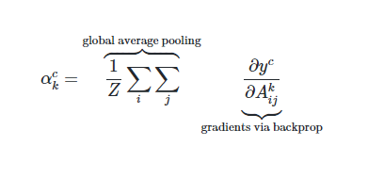
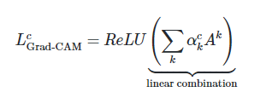
Algorithm
Select the class of interest ( target class)
Сalculate the gradient of the class logit nd the activation maps
Average over activations using the global average pooling
Obtain he neuron importance weights coefficients α k c for each map (this weight α c k represents a partial linearization of the deep network downstream from A, and captures the ‘importance’ of feature map k for a target class c)
Consider a linear combination
Apply ReLU
Interpolate the heat-map (increase the dimension)

Slide 7
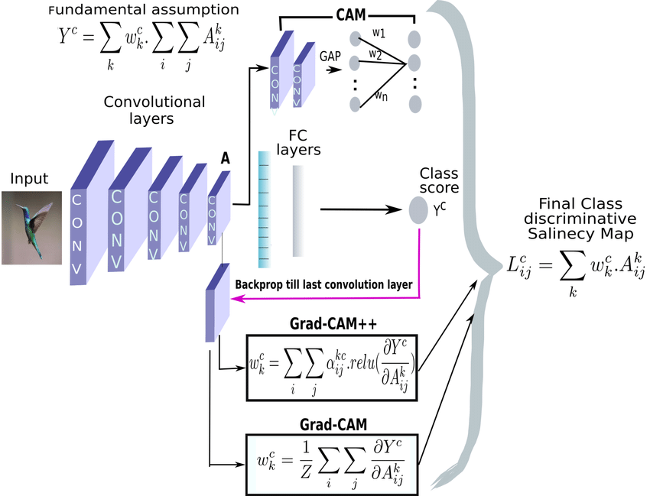
Grad-CAM

Slide 8
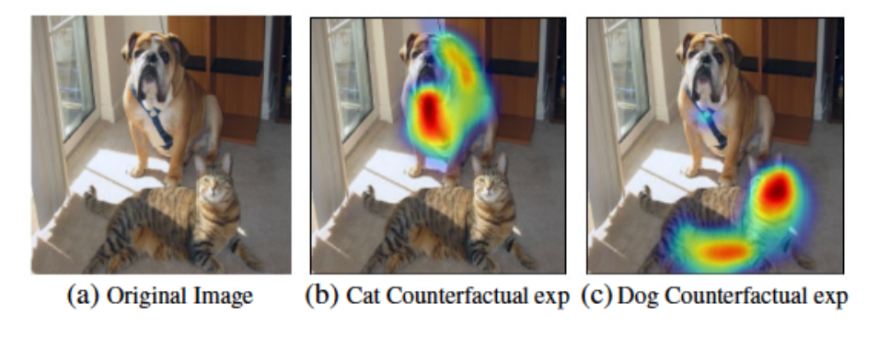
Grad-CAM – Gradient-weighted Class Activation Mapping

Slide 9
Guided Backprop
Idea: using gradient back propagation as it is except at the ReLU stages. Guided Backpropagation basically combines vanilla backpropagation and DeconvNets when handling the ReLU nonlinearity:
Like DeconvNets, in Guided Backpropagation we only backpropagate positive error signals – i.e. we set the negative gradients to zero (ref). This is the application of the ReLU to the error signal itself during the backward pass.
Like vanilla backpropagation, we also restrict ourselves to only positive inputs.
Thus, the gradient is “guided” by both the input and the error signal.

Slide 10
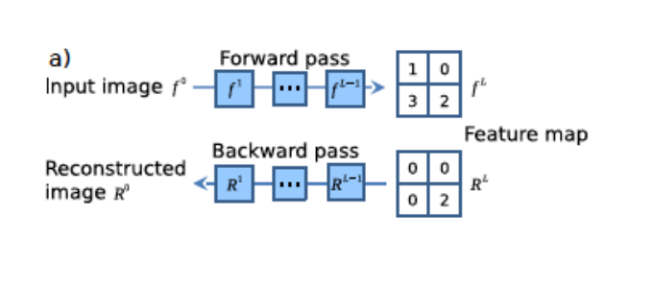
Guided Backprop
Select the layer we want to render; Select the activation on the feature map of this layer in order to find out which area on the image it responds to, then nullify the rest of the activations.
run the resulting feature map in DeconvNet: first we do unpooling,then rectification and then apply the transposed convolutional filter corresponding to this convolutional layer in the original network to reconstruct the activations in the previous layer that led to this activation.
Thus, at the output, we get those pixels that influenced the activation of the selected neuron.

Slide 11
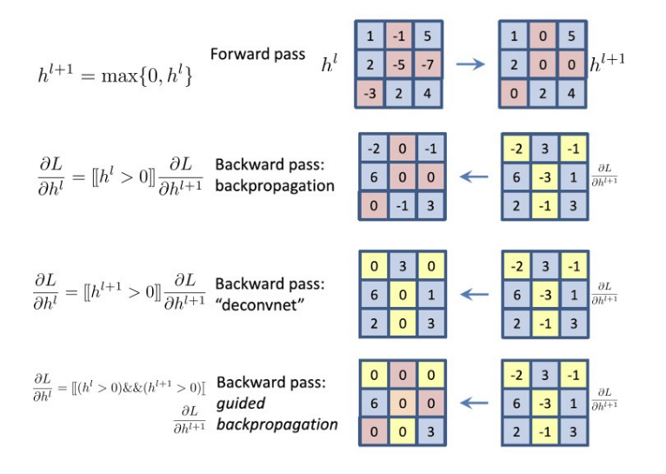
Guided Backprop
Before applying ReLU, there are negative values ​​on the feature map in some places, after ReLU they will be zero.
Then, on the backward pass in the reverse relu, we will zero the values ​​in the same places as in the forward (while some values ​​may remain negative and spread further, and some positive ones will vanish).
The second reverse relu operation in the guided backprob is essentially a regular relu. That is, having a feature map, when it propagates, we will zero out negative values.and leave positive.

Slide 12
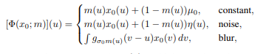
Meaningful Perturbation
The aim of saliency is to identify which regions of an image x0 are used by the black box to produce the output value f(x0).
The idea: observing how the value of f(x) changes as x is obtained “deleting” different regions R of x0.

Slide 13
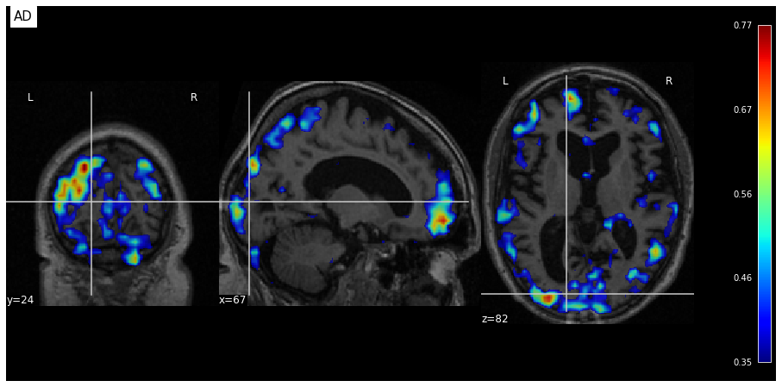
Meaningful Perturbation
ADNI - AD/CN Model without skull

Slide 14
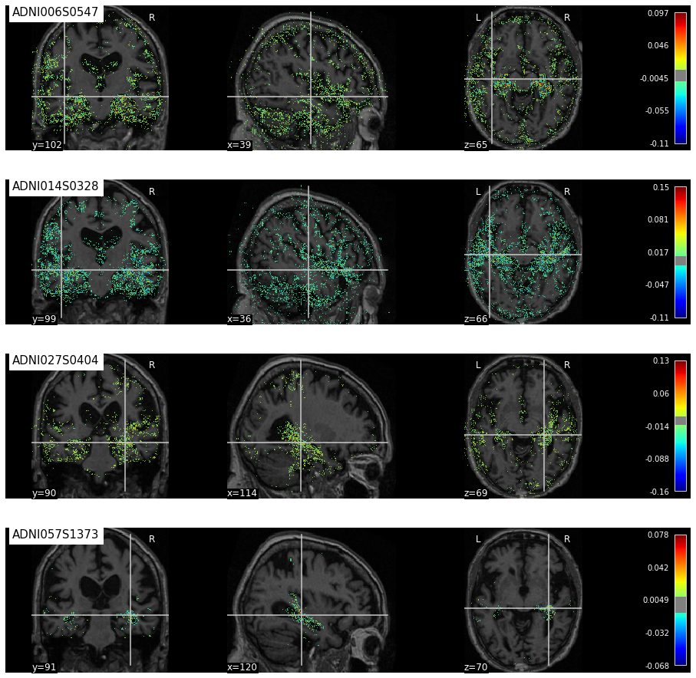
Guided Backprop
ADNI - AD/CN Model without skull

Slide 15
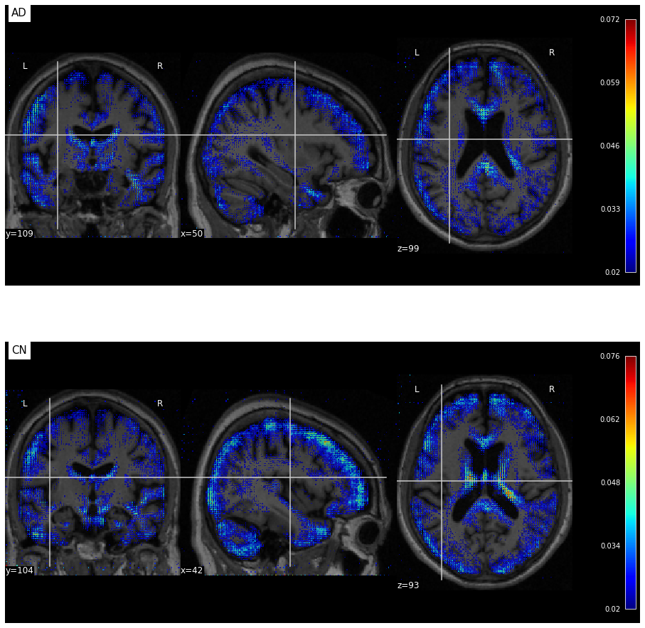
Guided Backprop
ADNI - AD/CN Model without skull

Slide 16
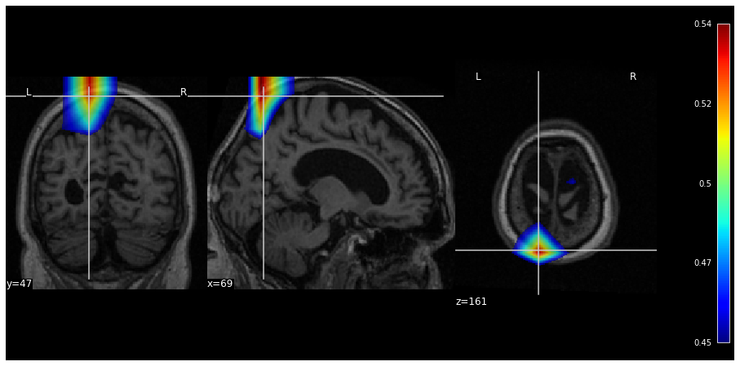
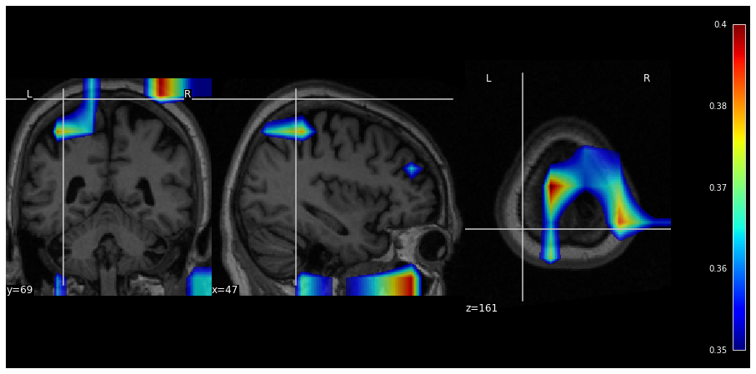
Grad-CAM
ADNI - AD/CN Model without skull

Slide 17
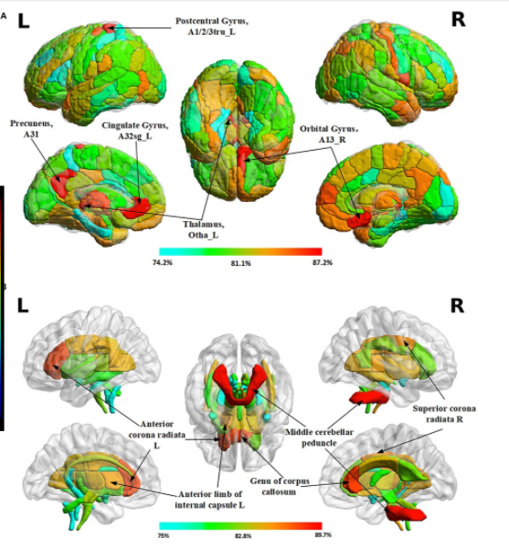
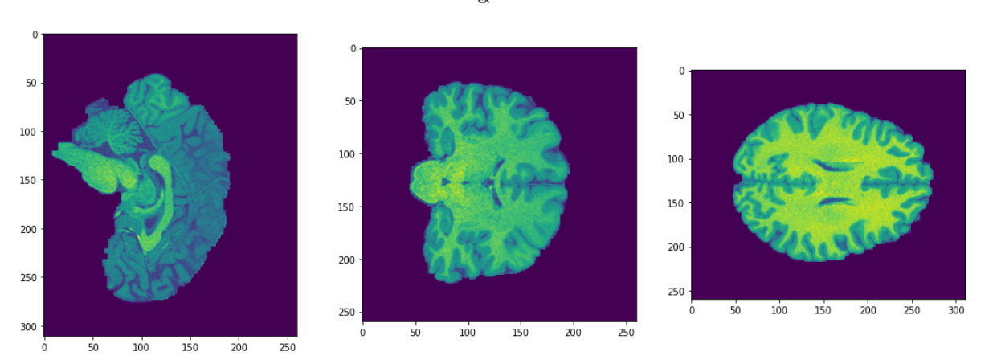
Task of gender patterns recognition
Human Connection Project (HCP)
1112 subjects
575 female
535 male
Notes:
for the task of gender patterns recognition between men and women in some articles mentioned the difference in the cerebellum for different sexes. Thus, looking back at the examples of interpretation, where this particular area is highlighted, we can assume that the model's decision for classification is justified.

Slide 18
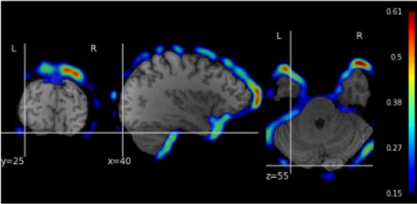
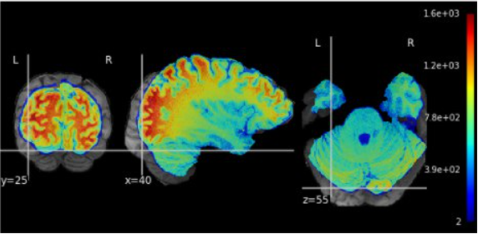
HCP: RESULTS
Smart augmentation: Opti­mal Scale based on Optimal Transport (OT)
one continuous probability distribution (men) is transformed into another (women)
the correct scaling coefficient for each subject
Notes:
rotation(arbitrarilywithdegrees = [0, 15]), scaling(arbitrarilywithcoef = [0.8,1.2])and a proposed new methodology of smart augmentation where scaling coefficients is found Opti­mal Scale based on Optimal Transport (OT) [24]. With the help of OT, taking measurements by the volume of the brain as a basis (this data are in the public domain, as part of HCP), one continuous probability distribution (men) is transformed into another (women). As a result, it is possible to select the correct scaling coefficient to equalize the brain volume among men and women, so thatthe model pays attention not to this feature, but to the structure of the brain itself

Slide 19
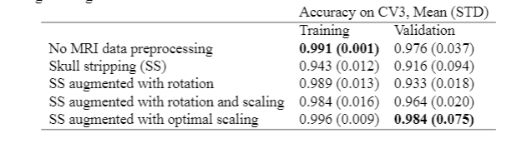
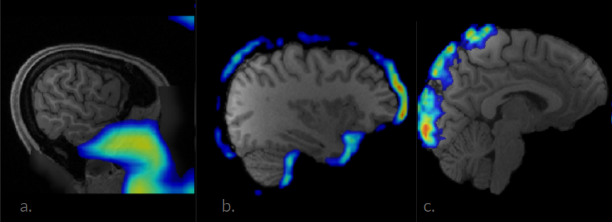
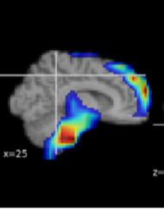
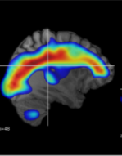
HCP: RESULTS
Example of GradCAM attention map (0 class):
(a) on data without preprocessing:the model pays attention to nasopharynx and Adam’s apple area;
(b) on data with skull stripping:model pays attention to the difference in brain size;
(c) data trained with advanced augmentation:optimal scaling force the model to base its decision only on the brain structures
Notes:
raw data without preprocessing, cropping from (256, 320,320) to (176, 260, 230) size; MRI data with skull stripping (FSL Bet) and data with stronger preprocessing, compressed from size (256, 320, 320) to (58,70,58)

Slide 20
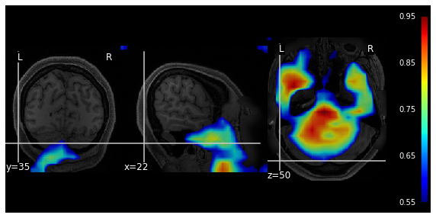
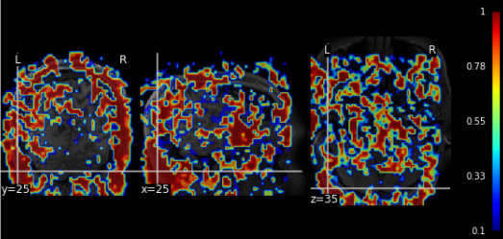
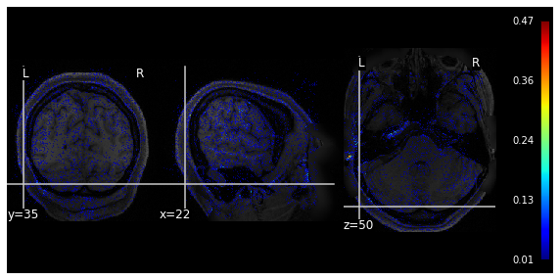
Training without pre-processing and without skull-stripping
Meaningful perturbations
GradCam
Guided Backpropagation

Slide 21
Sanity Check

Slide 22
Model Randomization Test
randomize the weights of a model starting from the top layer, successively, all the way to the bottom layer. This procedure destroys the learned weights from the top layers to the bottom ones. We compare the resulting explanation from a network with random weights to the one obtained with the model’s original weights
Notes:
Interpretation methods often guided by visual appeal on image data. But it can be misleading.There is special sanity check that show that some methods are independent both of the model and of the data generating process and actually cannot interpret result correct.

Slide 23
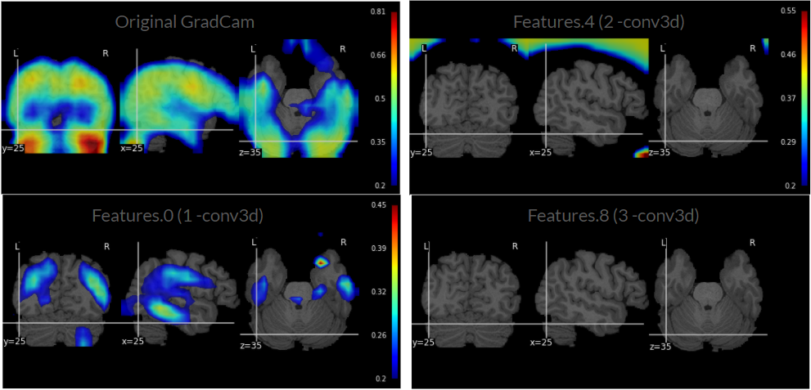
Model Randomization Test GradCam

Slide 24
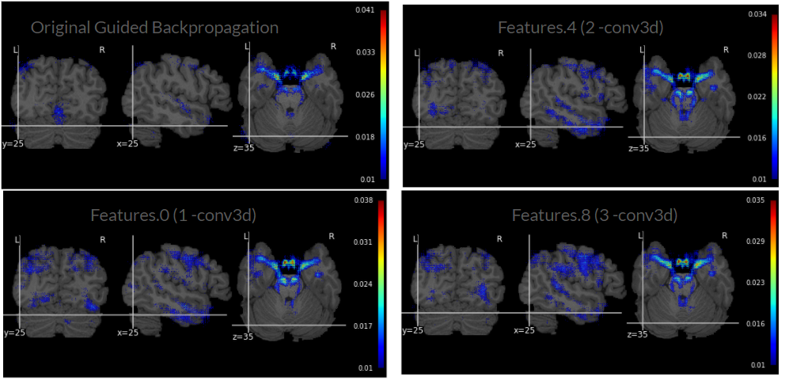
Model Randomization Test
Guided Backpropagatio

Slide 25
Data Randomization Test
permute the training labels and train a model on the randomized training data.
A model achieving high training accuracy on the randomized training data is forced to memorize the randomized labels without being able to exploit the original structure in the data. We now compare saliency masks for a model trained on random labels and one trained true labels.

Slide 26
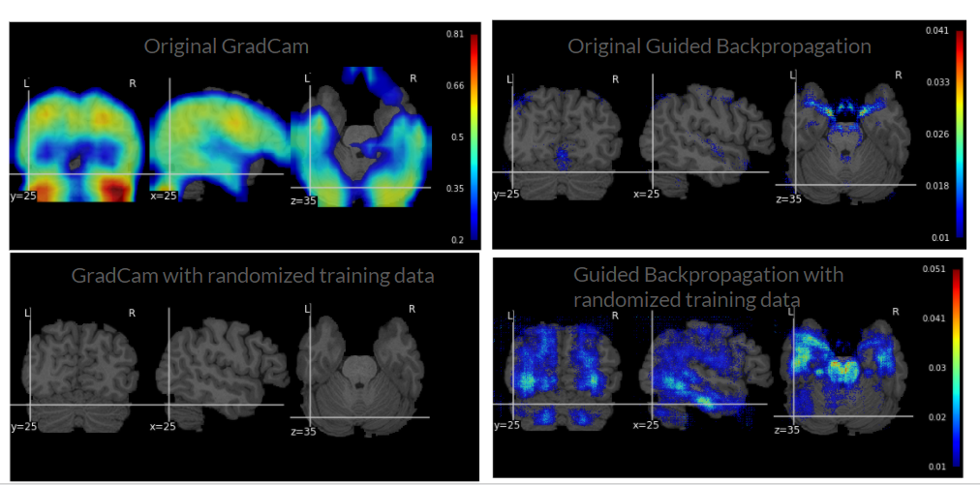
Data Randomization Test

Slide 27
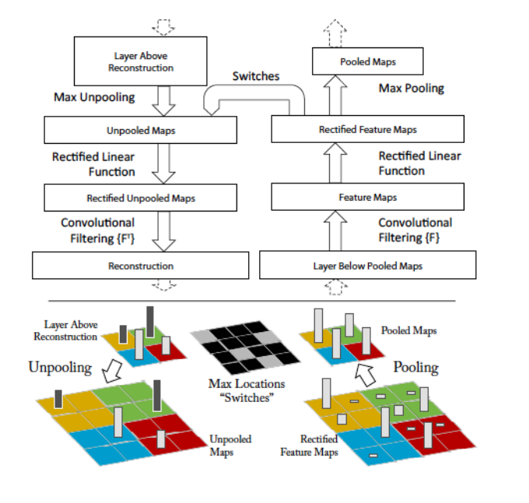
Guided Backprop
on the forward pass, we “remember” the positions of the maximum activation values for each layer, that is, the values of the local maximums in each pooling area (for example, a 2x2 square) are stored in so-called switches.
Then, on the backward pass, we return the maximum activations to the same places using these switches.

